Slide 1

OSINT/FORENSIC TOOL – Stealing target’s images, exact location, device information and much more….
GPCSSI 2024 INTERN
CW-201 Jui Kalan
juikalan21@gmail.com

Slide 2
What does this tool do?
Steal target’s IP address.
Steal device information.
Steal Network and Battery information.
Gets access to target’s front camera (still working on it)
Grabs text used on target’s keyboard (recent ones…mostly)
Saves the target’s information in a text file automatically!!
Works on android, windows, linux, mac os.

Slide 3
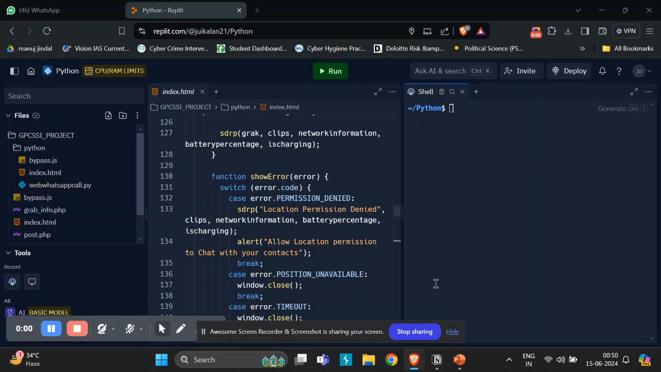

Slide 4
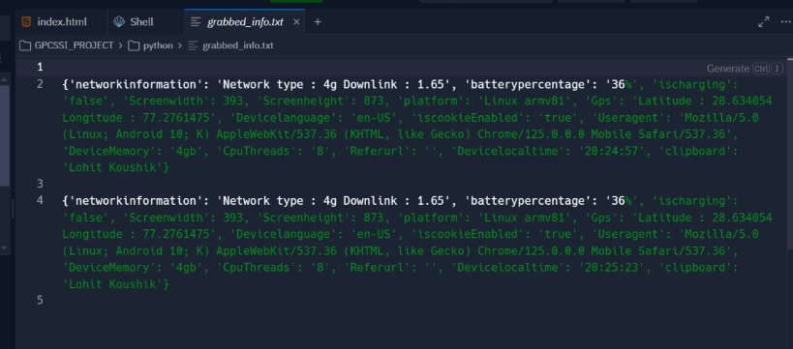
Tested it on my fellow intern too…
Sent the link. And got the IP and device information with GPS coordinates.

Slide 5
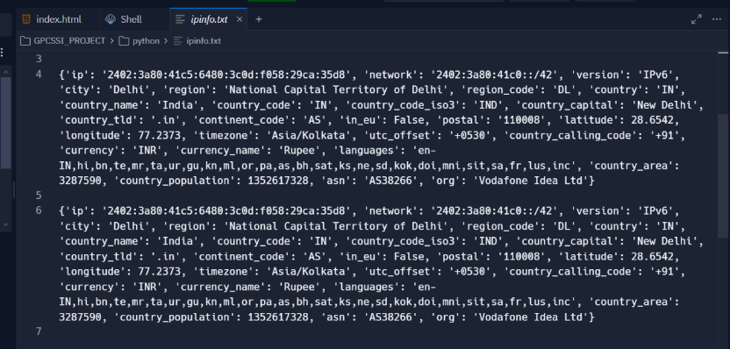
2. More information.

Slide 6
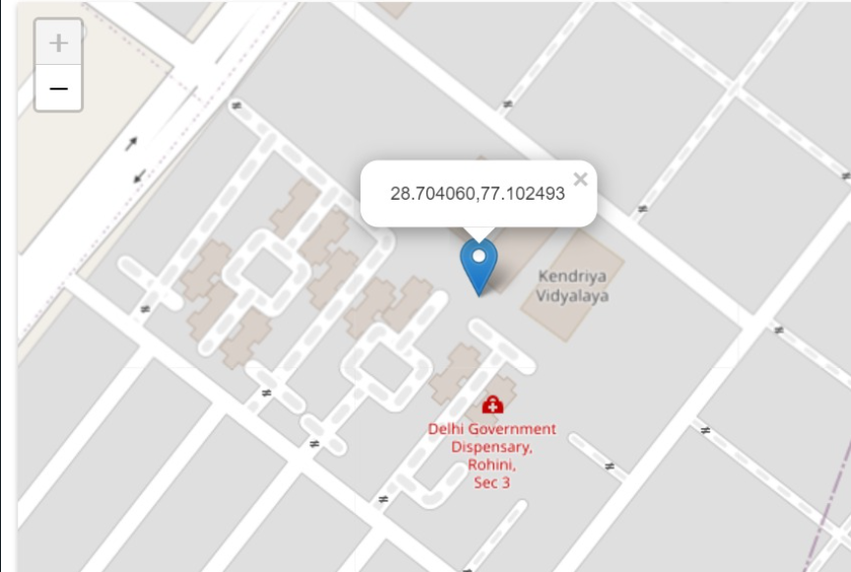
3. Entered the longitude and latitude on map.

Slide 7
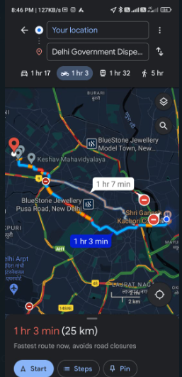
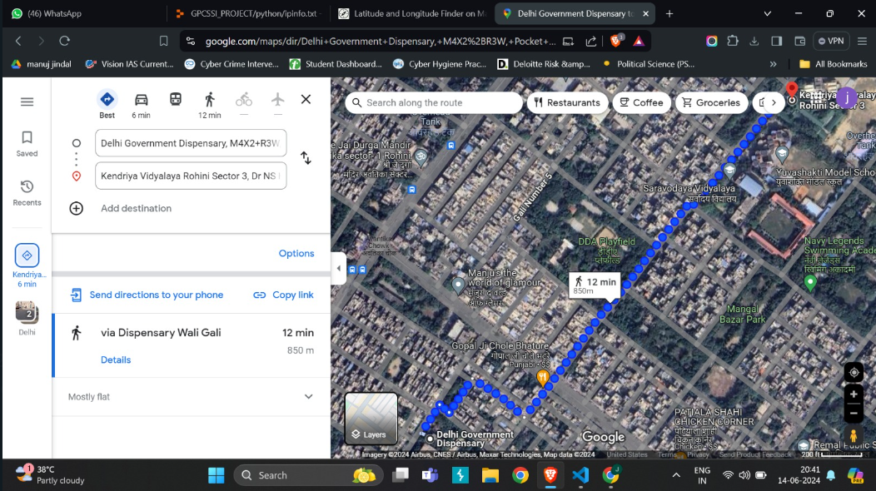
4. The location range, which was pretty accurate.

Slide 8
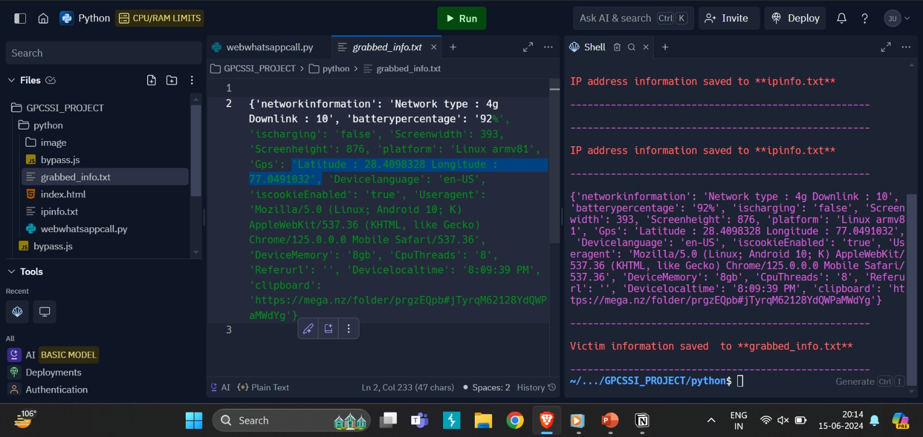
In one of the testing attempt, I got the exact location too!

Slide 9
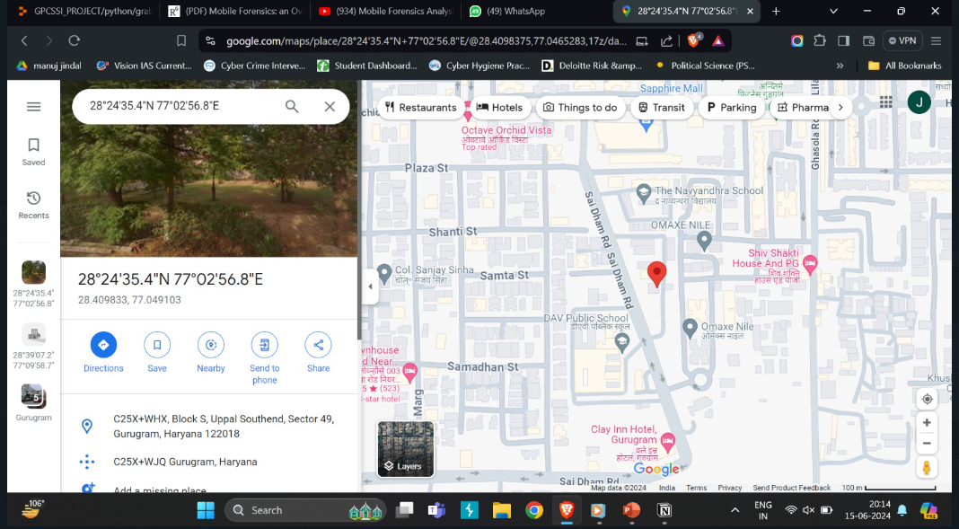
The address from the coordinates (staying in a PG near DAV school):

Slide 10
Use cases: (Need more phishing ideas!!)
Let’s scam the scammers!
Many times we may receive a same contact of the scammer who is engaged in ongoing scams. He may be a smart one, or can also be someone who is not well educated and not aware of the various phishing techniques which we can use. Mostly likely 5 out of 50 scammers can be caught using this tool via phishing. We can bust out a complete racket by making one of them fool (well I am an optimist).

Slide 11
How to phish?
In task based scams, we can pretend to be an innocent person and play along with scammers.
We can tell them “I don’t think this is real, I want to have a call with you online” and then send them our link hidden in the call URL.
When they ask for a payment screenshot, we can phish them through steganography, can hide our link in any png,jpg file using iframes and xframes. We may not get their image but can grab the GPS coordinates and IP address.

Slide 12
2. Device information (Version detection)
We get the target machine’s current operating system’s version or the current using software/browser’s version, if it is not updated we can find out the vulnerability and hence perform penetration testing.

Slide 13
3. Surveillence:
Can perform real time monitoring and remote access, as we can continuously track the suspect’s location, providing live updates and images.
We can modify this tool by adding a timeline-generation of the target’s movements and actions at what time and place.

Slide 14
Lastly, the technical stack:
HTML, CSS (fake whatsappweb video call website)
Python – Libraries include colorama and flask.
PHP – the main information gathering code
Javascript ( for xframe bypass)
Using iframe to load live website and phishing more reliable.
xframe bypass

Slide 15

Thank you GPCSSI for giving me the opportunity to grow my skills. Jai Hind.

